Slide 1

“Website Digg” Project Soraia Felício
Analysis of Social Networks and Information
Professor: Carlos Soares
<número>

Slide 2
Agenda
Context of the project
Problem definition
Results general
Results in relation to a particular user
Conclusions
<número>

Slide 3
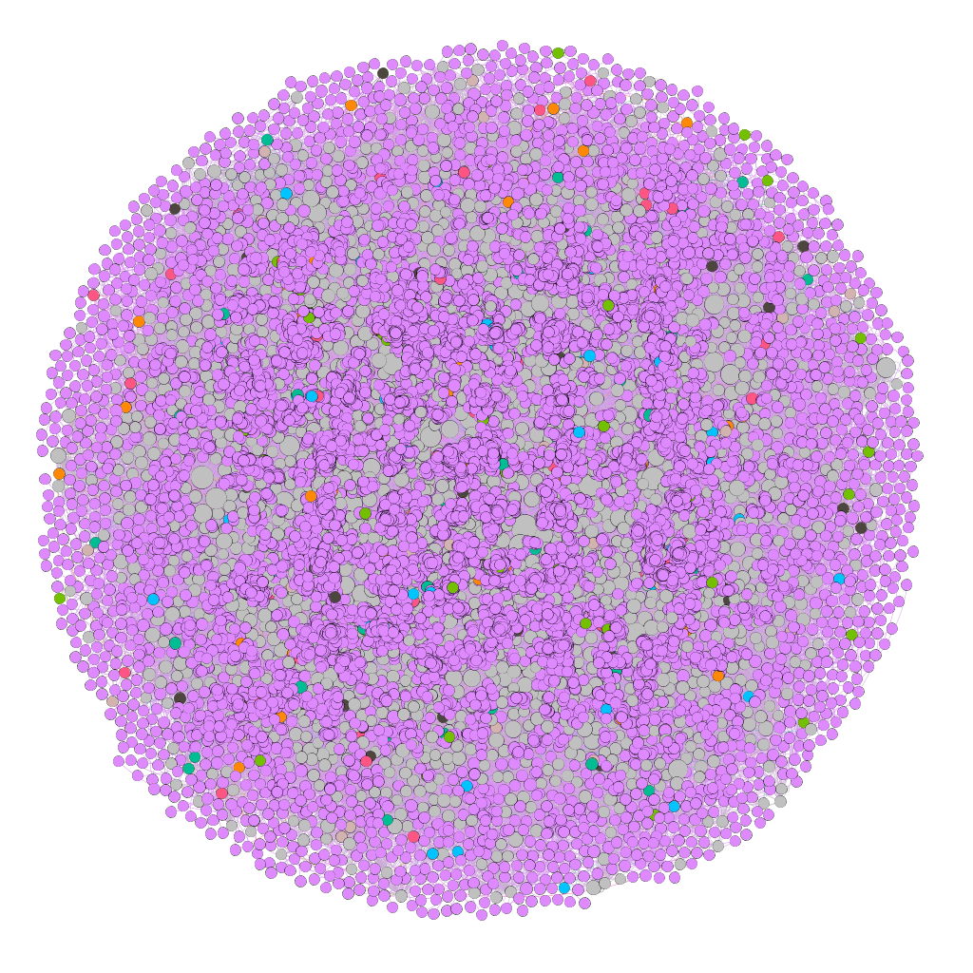
Context of the Project
Digg is a news aggregator that includes linking or sharing stories around a particular topic.
Data analysed in this Project is about communication: each node in the network is a user of the website, and each directed edge denotes that a user replied to another user.
<número>

Slide 4
Context of the Project: Information of the Digg network
Type Information | Digg network
Repository | Konect - Koblenz network collection. Has three categories of the Digg: communication, rating and social.
Format | Directed
Nodes (users) | 30,398
Edges (replies) | 87,627
Category | Communication
Tools | Gephi and Jupyter
<número>

Slide 5
Problem definition
In a more general context, how to evaluate in a network "who-talks-to-whom" the groups that are formed in a certain period of time and what conclusions we can obtain with these analysis, if we disconsider the context.
This analysis was performed in the part of the social network Digg that has only one user action (which each user responded to other users), in a given time interval.
Is it possible to find that seed user when we disconsider the context?
How to rate the most popular user on a network “who-talks-to-whom"?
Can we predict some synchronism of behavior in this network from the perspective only in the action of responding to the other user without considering the context?
<número>

Slide 6
Results general
Statistics of the Gephi in relation to nodes (users) | Usage | Result | Meanings for the project
Clustering coefficient | probability to form triangles or possibility that at least one set of users are friends. | 0.008 in relation to average | This low value of clustering coefficient within Digg means there is little possibility of a pair of users in Digg being connected to another user, perhaps for they discuss different subjects.
Modularity class | it divide the nodes in group or class | 0.381 Modularity Coefficient and 461 communities | This result confirms the previous result that users form several small groups, that is, many communities. The Digg is a news network, hence the users discuss different topics, forming many groups.
<número>

Slide 7
Results general
Statistics of the Gephi in relation to nodes (users) | Usage | Result | Meanings for the project
Strongly Connected ID | strong and weak ties | 23,652 strong connections and 373 weak connections | This result reveals that network users are strongly connected and the few weak ties that exist allow the formation of local bridges. What confirms the small-world model, through a few users it is possible to reach the most distant user.
<número>

Slide 8
Results general
Statistics of the Gephi in relation to nodes (users) | Usage | Result | Meanings for the project
In-degree | ** popularity => in-degree gregariousness* => out-degree * the quality of enjoying the company of other people.(Cambridge Dictionary) | 73.23% of the nodes in-degree less or equal than 2 | It is necessary to evaluate these users more deeply to know what type of influence they are exercising in the entire network, for this it is necessary to correlate with the topics they are interacting with.
** Source: Needham, M. and Hodler, A. E. Graph Algorithms: Practical Examples in Apache Spark and Neo4j 'Reilly Media, p. 79, 2019
<número>

Slide 9
Results general
Filter of the Gephi in relation to edges (communication) | Usage | Result | Meanings for the project
Mutual edges | To evaluate the edges of both directions. To evaluate the positive and negative relationship | 154 nodes and 184 edges | This number of nodes and edges is considered a positive relationship, ie, there is an exchange of messages that suggests an interaction and a relationship. This amount also reveals that the number of interactions is low in relation to the total number of users on the network.
<número>

Slide 10
Results general
Filter of the Gephi in relation to edges (communication) | Usage | Result | Meanings for the project
Avg Path Length | Total steps to your destination | 6.03 in relation to this average | This number confirms six degrees of separation in relation to small-world phenomenon within the Digg. That means which in a few steps arrive at the final destination. A reply within Digg arrives at the final user in approximately (6.03) steps.
<número>

Slide 11
Results general: Homophily
Statistics Information of the Koblenz | Values | Meanings for the project
Assortativity | 0.0046449 | Low ability to associate with other users. Suggesting that there are few similarities within the network.
Reciprocity | 1.55% | That indicates little interaction.
<número>

Slide 12
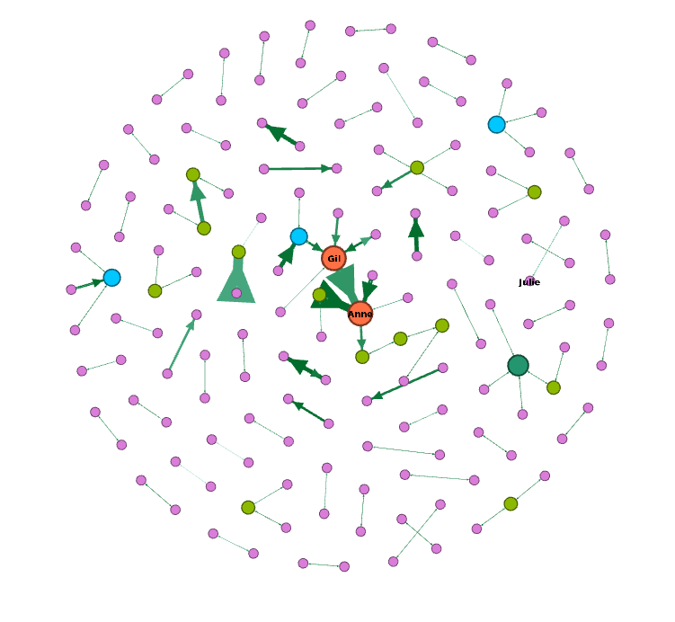
Results general: Balance Theorem of the Digg
There is a set of users that could be friends or else the users can be divided in two groups, in that at least a pair in each group like each other, and at least at the other end the pairs are enemies.
This is observed with the relationships that we consider to be positive, because there is interaction between them and the relationships that have not interactions between them, we consider negatives.
The graph on the side shows only the users who interacted. We noticed that there are few users that have interactions between them.
Additionally, the users with fictitious names: Gil and Anne stood out in relation to the interactions. The user Julie had not very prominent, but she will be referenced at another time when we evaluate the popularity and that is why it was presented in this graph.
<número>

Slide 13
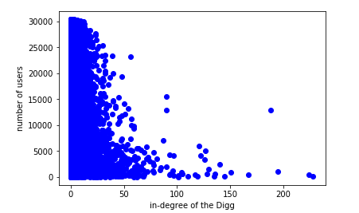
Results general: Long tail
We observe the user who received the most replies. They will be investigated in the next analysis.
This concept is based on the principle that popularity is only for a few. We see from the graphic above. In relation to Digg, the popularity is concentrated among the first 15,000 users. This popularity is relationed to the quantity of reply that the users received (in-degree).
<número>

Slide 14

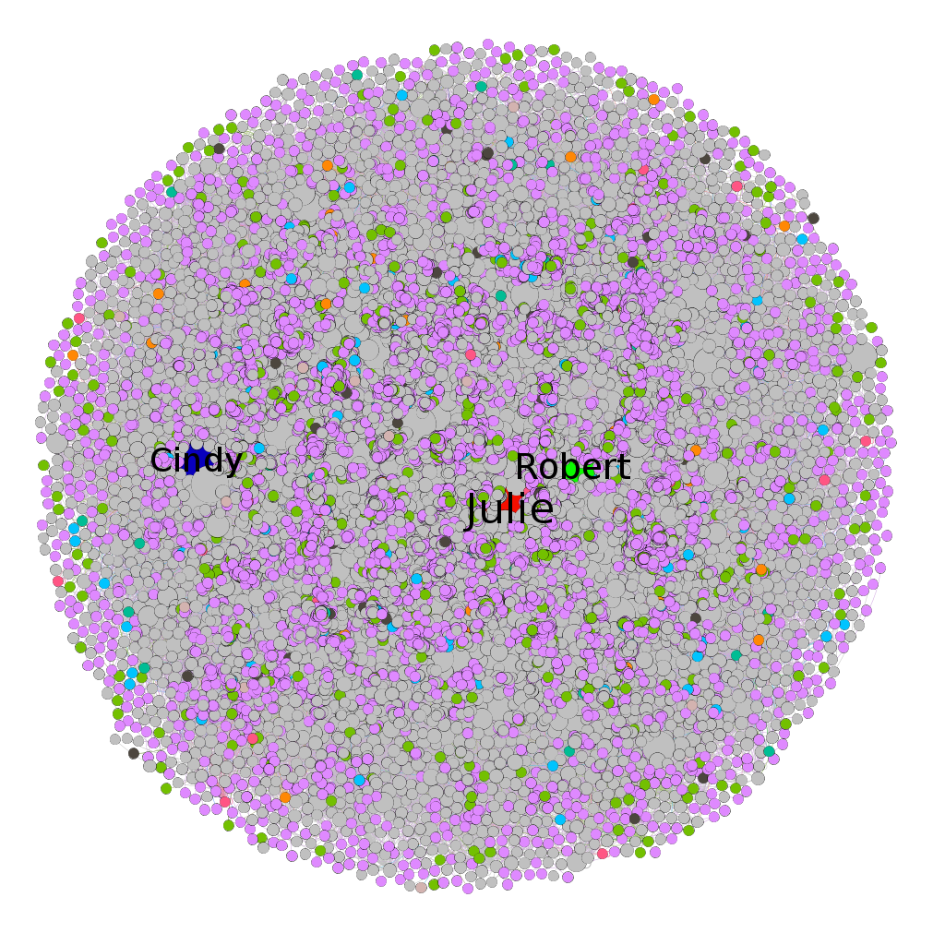
Results general: Rich-get-Richer in relation to Digg
This network has some user more popularities, for example, Julie (red node), and Robert (green node) and Cindy (dark blue node). According to the analysis previously, this popularity is relationed to the quantity reply received for them, that is confirmed in the table above of the graph, which shows Julie, Robert and Cindy with high number of eigenvector centrality and in-degree. The popularity of Julie arouses our interest in investigating more about this influence of Julie within Digg, as is shown in the next analysis.
<número>

Slide 15
Some test with particular user and more results
To answer the research questions, some tests were done on a specific user. Following are more tests with three users who are related between them, through their replies in the Digg. The choice criterion was the most popular user from the previous analyzes: Julie (fictitious name) and whoever relates to her within her community.
<número>

Slide 16
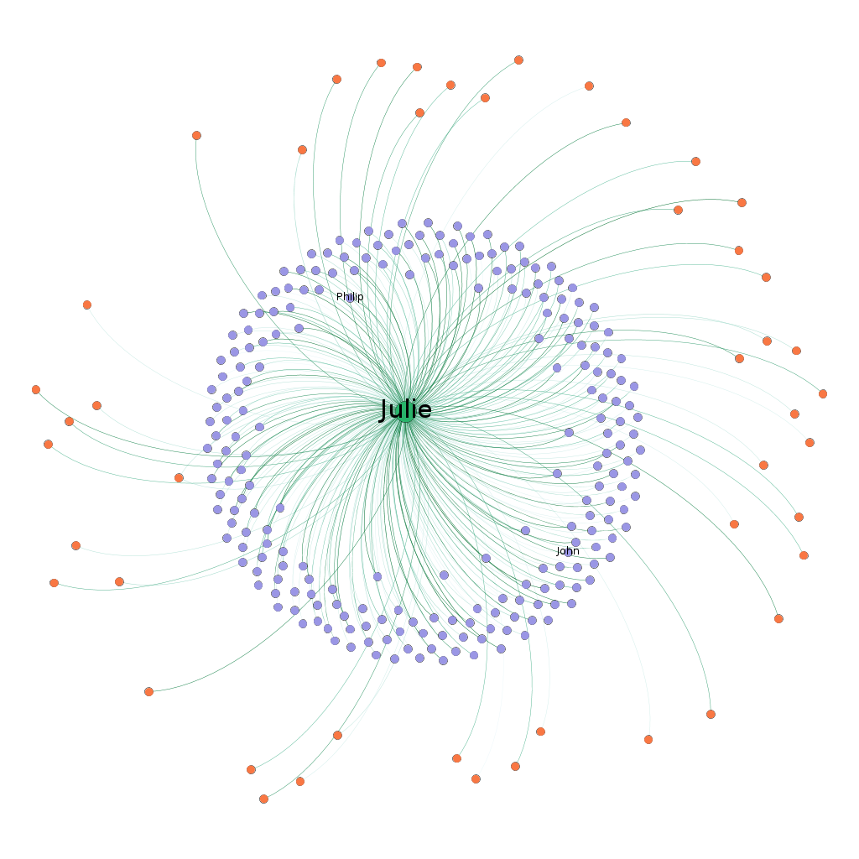
Results correlated with Cascading Behaviour
Julie receives many messages suggesting that her interests arouse interest in other users. Somehow, her behavior can influence others.
<número>

Slide 17
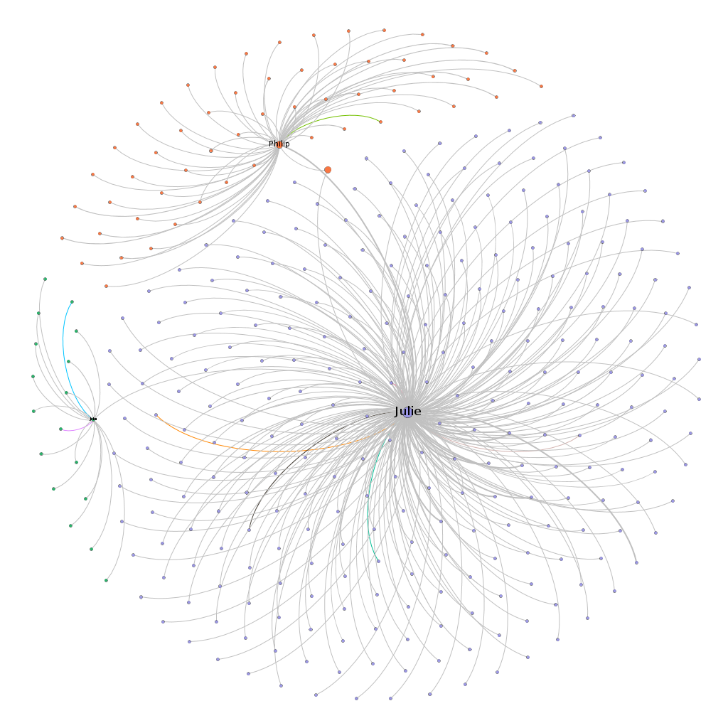
Results correlated with the
Small-World
This is proven when choosing other users close to her who form a bridge in relation to their communities. Suggesting that the behavior of the previously chosen user may influence other users and communities.
This is related to the concepts of homophily, behavior cascade and epidemic model.
<número>

Slide 18

Results correlated with the
Epidemic model
This video shows the effect of the epidemic model over a period of time. This effect is observed as the communication spreads, adding new users to the network. In this observation, we identified the synchrony phenomenon. As new seed users are added over a period of time, other users are added to the network. We observe the equivalence of the synchrony phenomenon to the concept of epidemic model.
t1 t2 t3
<número>

Slide 19
Results correlated with the Game Theory
Julie is more famous than Philip, then
If she replies, she will receive a higher value than Philip.
If she doesn’t reply, she will receive a lower value than Philip.
Each box represents (Julie, Philip)
Philip
Reply
No Reply
Reply No Reply
1,5 | -2,10
2,-3 | -1,-2
Julie
In this situation within the Digg, Julie doesn't reply to Philip, but Philip replies to Julie. We see that Julie is once again influencing Philip of some form. The table above shows the rewards values, considering notoriety/popularity assuming Julie is more famous air eady than Philip in relation to the replies received. We note that encouraging interaction between the users is not a Digg strategy, but it could be.
<número>

Slide 20
Discussion
These analysis reveal some clues about the research questions raised and previously and about the network in general:
1) The network does not have much interaction, although it is strongly connected, but this is justified because it is a news classification network as main focus and not interaction between users. This is perceived by the large amount of communication that involves the network as a whole, but with few communications carried out in both directions (positive relationship). In addition to some evidence of similarities, that is, homophily.
2) There are a few users who stand out in relation to the number of responses they have, justifying the existence of a great number of users strongly connected, because this users of any way influence others users, arousing more connections between them.
3) We consider seed users, the users have high degrees and eigenvector centrality, ie, a lot of popularity.
4) The most popular user suggests that there is a synchronism and influence in relation to other users. As it is a small-world phenomenon it can spread its influence and impact the social network as a whole. Digg could consider in its functionalities topics that these users show more interest or the functionalities of following them, as it exists in other social networks.
<número>

Slide 21
Conclusions
We identify the seed user, using the metric that measures popularity (in-degree and eigenvector centrality), thereby showing how to identify the popularity of a "who-talks-to-whom" social network.
We showed a social synchronism between three users over a period of time without considering the context. Our conclusion is that there are few popular users, as described by the concept "long tail", but they are able to influence the behavior of several other users of the social network.
We recommend that the interests of these users are observed so that in a network like Digg it will create new features, such as how to follow more popular users or recommend the same news of interest to these users, in addition to the news already recommended directly by users of the network by vote.
As a future work, we also recommend looking at users who have many interactions to assess whether these users form groups or whether they are just part of a group and do not have much influence within their groups or are simply people who like to relate. Thus, how can a social network benefit from this type of person and help other people.
<número>

Slide 22
References
Data source: http://konect.uni-koblenz.de/networks/munmun_digg_reply
Easley, D, and Kleinberg, J. Networks, Crowds, and Markets: Reasoning about a Highly Connected World. Cambridge University Press, 2010.
Munmun De Choudhury, Hari Sundaram, Ajita John, and Dorée Duncan Seligmann. Social synchrony: Predicting mimicry of user actions in online social media. In Proc. Int. Conf. on Computational Science and Engineering, pages 151--158, 2009.
Needham, M. and Hodler, A. E. Graph Algorithms: Practical Examples in Apache Spark and Neo4j 'Reilly Media, 2019.
<número>

Slide 23

Thank you!
<número>

